Slide 1
Ayrık Zaman Matlab Uygulamaları
Yrd. Doç. Dr. Meriç ÇETİN

Slide 2
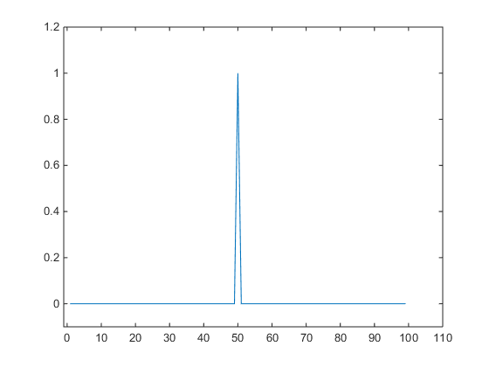
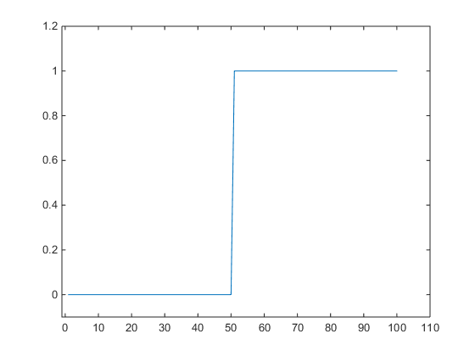
Birim Basamak ve Birim Darbe Fonksiyonu
%delta function
u = [zeros(1,50),ones(1,50)];
%step function
delta = [zeros(1,49),1, zeros(1,49)];
figure,plot(delta); axis([-1 110 -0.1 1.2])
figure,plot(u); axis([-1 110 -0.1 1.2])

Slide 3
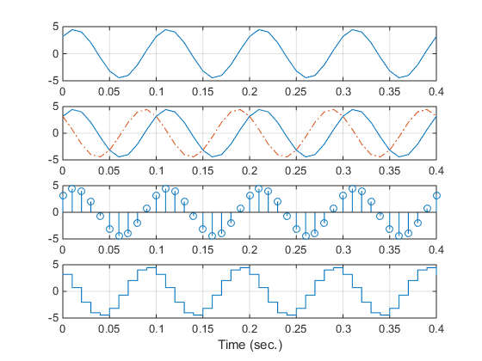
t=0:0.01:0.4; %Create time vector for time instants from 0 to 0.4 second
xx = 4.5*sin(2*pi*10*t + pi/4);
yy = 4.5*cos(2*pi*10*t + pi/4);
subplot(4,1,1), plot(t,xx);grid
subplot(4,1,2),plot(t,xx,t,yy,'-.');grid
subplot(4,1,3),stem(t,xx);grid
subplot(4,1,4), stairs(t,yy);grid
xlabel('Time (sec.)');

Slide 4
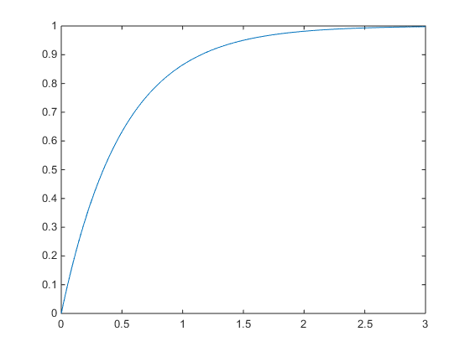
Basamak Cevabı
H(s) = 2/(s+2) için
num = 2;
den = [1 2];
t = 0:.001:3; % for a time constant of 1/2
y = step(num,den,t);
plot(t,y)

Slide 5
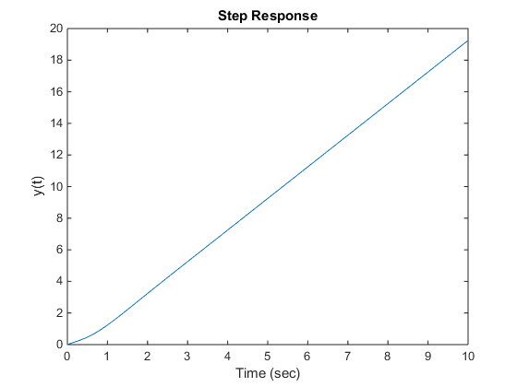
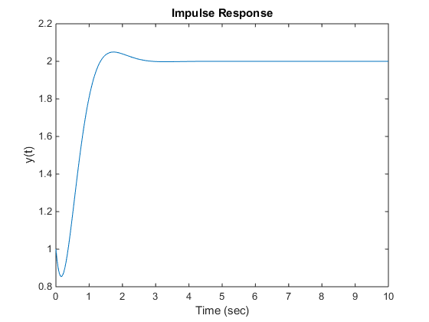
% step response
num = [1 2 16];
den = [1 4 8 0];
t = 0:10/300:10;
y=step(num,den,t);
plot(t,y),xlabel('Time (sec)'),ylabel('y(t)')
title('Step Response')
pause,figure
% impulse response
y=impulse(num,den,t);
plot(t,y),xlabel('Time (sec)'),ylabel('y(t)')
title('Impulse Response')

Slide 6
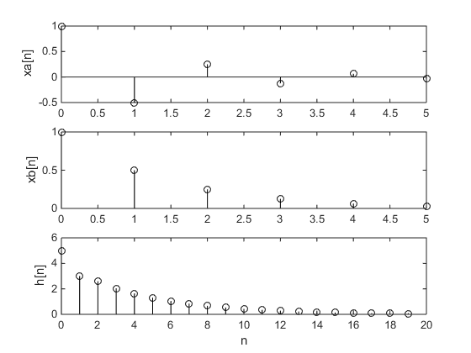
n=0:5;
xa = (-0.5).^n;
xb = (2).^(-n);
xc = (-2).^n;
subplot(311),stem(n,xa,'k');ylabel('xa[n]')
subplot(312),stem(n,xb,'k');ylabel('xb[n]')
subplot(313),stem(n,xc,'k');ylabel('xc[n]')

Slide 7
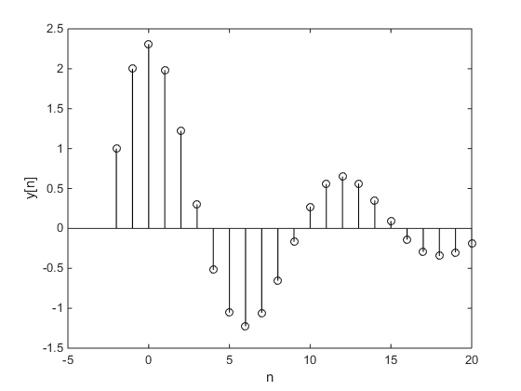
Ayrık zamanda y_{SGC}
clc, clear all, close all
n = (-2:20)';
y = [1;2;zeros(length(n)-2,1)];
for k =1:length(n)-2
y(k+2)=1.56*y(k+1)-0.81*y(k);
end
stem(n,y,'k');xlabel('n');ylabel('y[n]')
disp('n y');
disp([num2str([n,y])]);

Slide 8
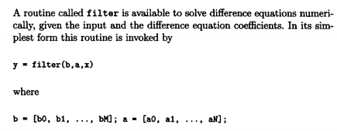
filter()

Slide 9
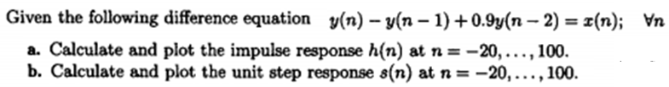
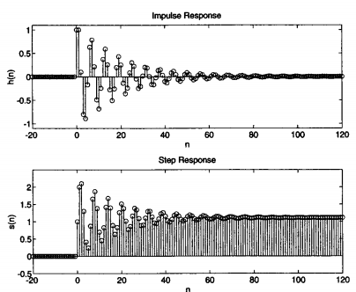
filter()
clc,clear all,
num=[1]; den=[1 -1 0.9];n=0:120;
x=impseq(0,0,120);
h=filter(num,den,x);
subplot(211),stem(n,h), title('unit impulse respose');
num=[1]; den=[1 -1 0.9];n=0:120;
z=stepseq(0,0,120);
h=filter(num,den,z);
subplot(212),stem(n,h), title('unit step respose');
function [x,n]=stepseq(n0,n1,n2)
n = [n1:n2];
x = [(n-n0)>=0];
function [x,n]=impseq(n0,n1,n2)
n = [n1:n2];
x = [(n-n0)==0];

Slide 10
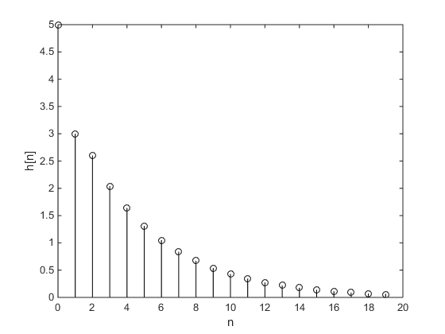
Ayrık zamanda birim darbe cevabı
n = (0:19);
x = inline('n==0');
a=[1 -0.6 -0.16];
b=[5 0 0];
h=filter(b,a,x(n));
stem(n,h,'k');xlabel('n');ylabel('h[n]')
disp('n h');
disp([num2str([n',h'])]);

Slide 11
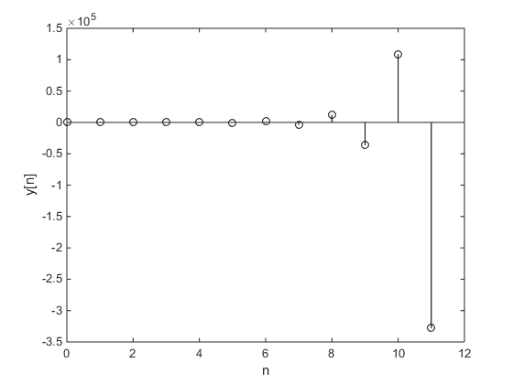
Ayrık zamanda y_{SDC}
n = (0:11);
x = inline('(4.^(-n)).*(n>=0)');
a=[1 6 9];
b=[2 6 0];
h=filter(b,a,x(n));
stem(n,h,'k');xlabel('n');ylabel('y[n]')

Slide 12

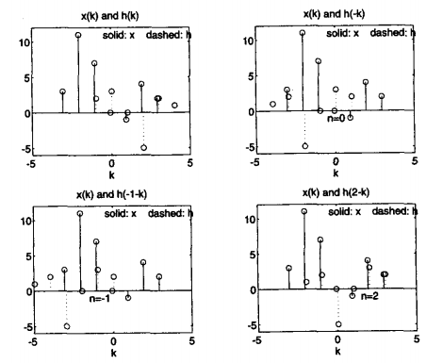
Ayrık Zamanda Konvolüsyon

Slide 13
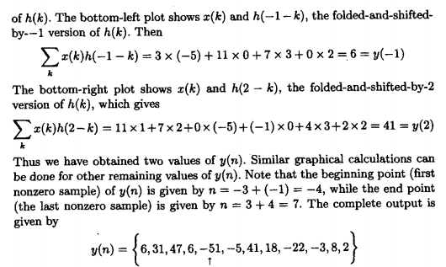
clear all
x=[3 11 7 0 -1 4 2];
h=[2 3 0 -5 2 1];
y=conv(x,h)

Slide 14
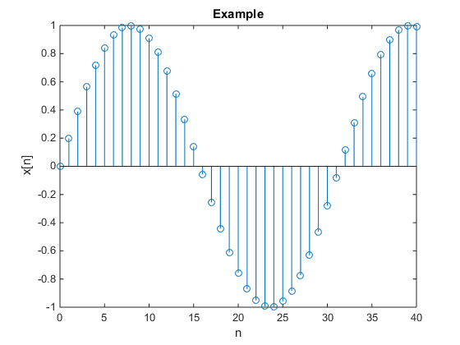
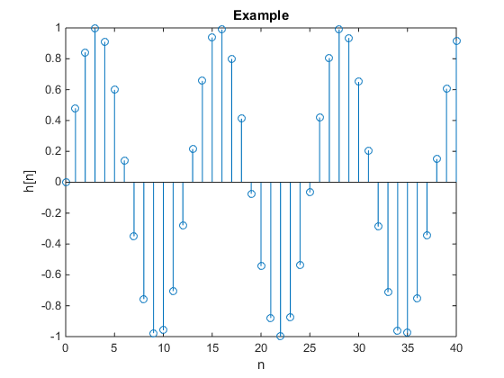
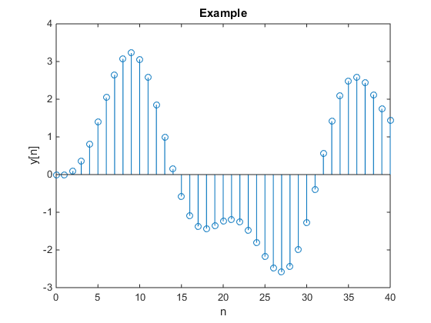
Ayrık Zamanda Konvolüsyon
n=0:40;
x = sin(0.2*n);
h = sin(0.5*n);
y = conv(x,h);
figure,stem(n,h);
title('Example'),xlabel('n'),ylabel('h[n]')
pause,figüre,stem(n,x)
title('Example'),xlabel('n'),ylabel('x[n]')
pause,figüre,stem(n,y(1:length(n)))
title('Example'),xlabel('n'),ylabel('y[n]')
x[n]*h[n] → Konvolüsyonu

Slide 15
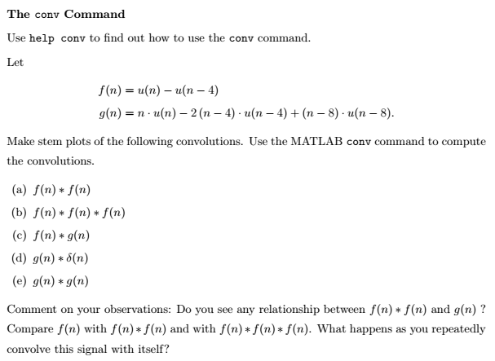
Alıştırma

